Slide 1
Video part System Architecture

Slide 2
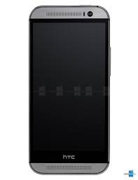
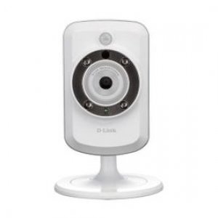
Send rtp packet
for display
RTP Server
Device Adapter
(RTSP Client)
Restream rtp packet
Get rtp packet
from cam
Get rtp packet and
decode it to image
Decoder

Slide 3
Video part System Architecture in Gateway
Re-Stream
RTSP Server
Our Protocol
RTP Server
Raw Data
RTSP Client
RTSP
RTP
RTP
IP Camera
Mobile
Extract Media
Raw Data
Media Decoder
CEP
Hbase Connector
Data Flow
Interaction

Slide 4
Video part System Architecture in Mobile
Gateway
Scenario Controller
UI
Model
ServiceHandler
Data View Convertor
Gateway
Model
Hbase
Depacketizer
Gateway Bar
Context
Model
RTP
MobileAP
Model
Decoder
MobileAP
TileView
H264

Slide 5
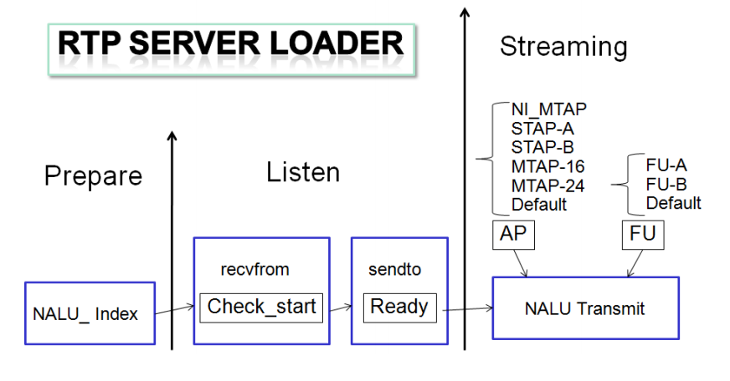
RTP Server Structure

Slide 6
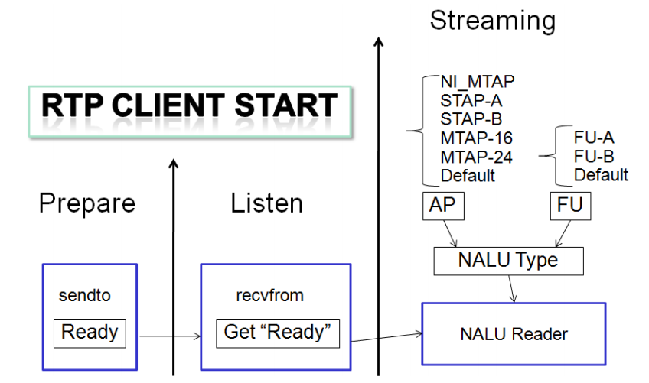
RTP Client Structure

